Slide 1

SMART INDIA HACKATHON 2026
Problem Statement ID - SIH26145
Problem Statement Title - AI-Based Detection of Cyber Threats in Unidirectional IP Traffic
Theme – Blockchain & Cyber Security
PS Category – Software
Team ID – COMP26
Team Name – The S.H.I.E.L.D
🔗

Slide 2
THE
S.H.I.E.L.D
Develop a passive threat detection pipeline by operating strictly behind one-directional hardware data diodes and analysing encrypted flow metadata through a fused Tri-Engine ML core, Diode Guard identifies both known volumetric attacks and novel zero-day botnet structures with sub-5ms latency and
zero operational attack surface.
Proposed Solution
Innovation / Uniqueness
Passive Ingress & Air-Gapped Monitoring: Ingests network flow telemetry in a strictly unidirectional, read-only monitoring enclave using hardware data diodes.
Ensuring zero risk of lateral movement or network tampering.
Payload-Agnostic Feature Extraction: Evaluates traffic patterns using flow-level metadata without decrypting payloads effective on TLS 1.3/QUIC traffic.
Tri-Engine Hybrid ML Detection Core:
Heuristic Engine : Real-time deterministic matching for high-velocity signature threats (DDoS, port scanning).
Isolation Forest : Dynamically isolates statistical anomalies and unexpected multi-dimensional traffic spikes from benign baselines.
Graph Neural Network : Constructs dynamic local interaction subgraphs via PyTorch Geometric to expose hidden topological threats.
Live SOC Visualization: Dispatches scored alerts and telemetry to a real-time React dashboard over Web Sockets with sub-50ms latency.
Fused Tri-Engine Detection: Combines the speed of deterministic rules, the novelty detection of unsupervised learning, and the structural intelligence of Graph Neural Networks (GNNs).
Graph Topological Modelling for Flows: Unlike conventional IDS that evaluate flows in isolation, Diode Guard models temporal topological relationships to unmask coordinated distributed botnets.
Hardware Data Diode Optimization: Built for critical infrastructure where active probing and traditional bidirectional firewalls introduce unacceptable vulnerability vectors.

Slide 3
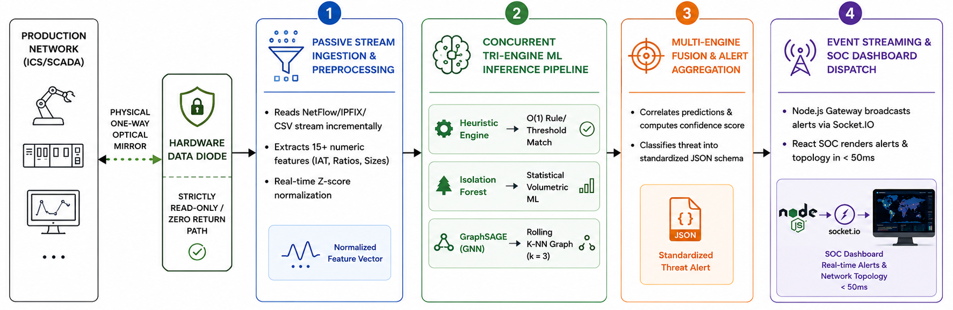

THE
S.H.I.E.L.D
Technical Approach - Technical Stack
User Interface
React.js + Vite
Tailwind CSS
Lucid Icons
ML Frameworks
NumPy & Pandas
PyTorch & PyG
Scikit-Learn
Backend
Node.js & Socket.IO
REST Inference
Flask
Ingress Env.
Hardware Data Diode
NetFlow/IPFIX
Flow Probes

Slide 4
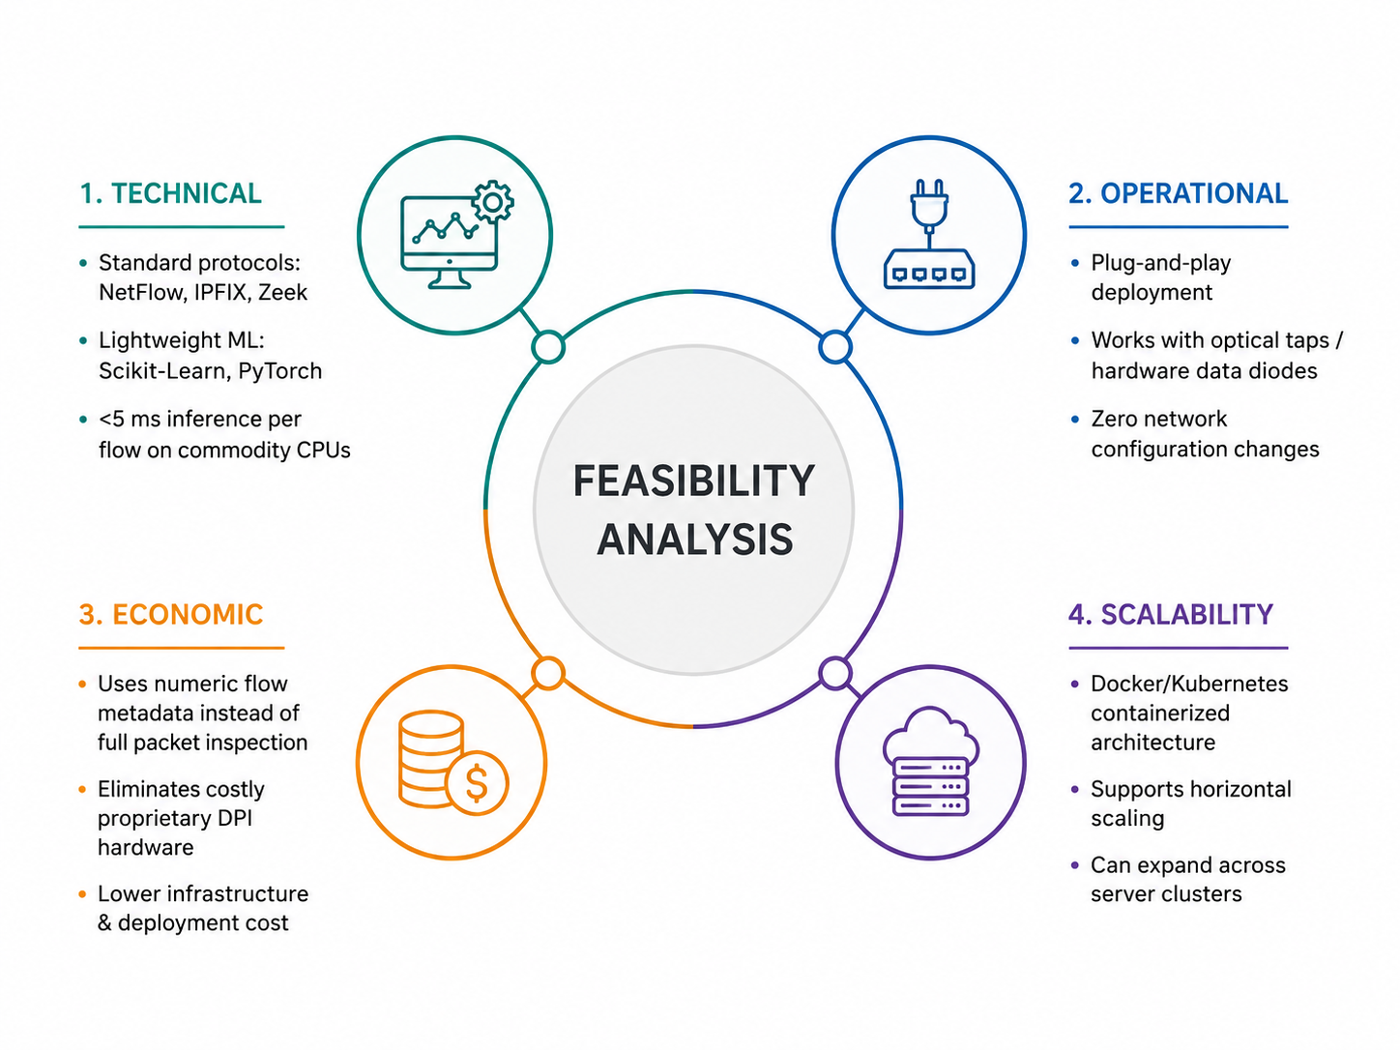
THE
S.H.I.E.L.D
Feasibility – Challenges & Risks
Challenges & Risk Area | Description & Threat Impact
1. Zero Payload Visibility | Pervasive end-to-end encryption blinds traditional DPI engines from inspecting packet content.
2. Strictly Read-Only | Hardware data diodes physically forbid two-way communication, preventing TCP resets, active probing, or challenge-response validation.
3. Real-Time Inference Bottlenecks | Deep Graph Neural Networks (GNNs) can introduce computational latency on high-throughput gigabit backbone lines.
4. False Positives & Concept Drift | Dynamic enterprise traffic shifts can trigger false alarms in unsupervised statistical models.

Slide 5
THE
S.H.I.E.L.D
Impacts & Benefits
Zero Operational Disruption: Ensures 24/7 continuous threat monitoring without risk of introducing latency, packet loss, or configuration instability into mission-critical ICS/SCADA systems.
Immunity to Lateral Pivoting: Even if external monitoring nodes are compromised, physically unidirectional data diodes prevent nation-state attackers from reaching production turbines, generators, or control systems
Reduced Alert Fatigue: Multi-engine fusion Rule + Isolation Forest + Graph SAGE prioritizes high-confidence structural threats over noisy single-packet false positives.
Social & Public Safety Benefits:
Civilian Infrastructure Protection: Prevents catastrophic cyber-physical blackouts, communication outages, and municipal water contamination caused by cyber attacks.
Economic & Financial Benefits:
Loss Prevention: Mitigates multi-million-dollar operational downtimes, regulatory penalties, and ransomware ransoms for national utilities.
Strategic & National Security Benefits:
Indigenous Cyber Defense: Replaces reliance on foreign black-box proprietary security appliances with an open, auditable, high-performance AI detection pipeline.

Slide 6
THE
S.H.I.E.L.D
Research & References
Graph Neural Networks - GraphSAGE Architecture:
Hamilton, W. L., Ying, R., & Leskovec, J. (2017). "Inductive Representation Learning on Large Graphs." Advances in Neural Information Processing Systems (NeurIPS).
Focus: Provides the mathematical foundation for dynamically embedding network flow topology without retraining on global graphs.
Unsupervised Anomaly Isolation:
Liu, F. T., Ting, K. M., & Zhou, Z. H. (2008). "Isolation Forest." IEEE International Conference on Data Mining (ICDM).
Focus: Basis for fast, multi-dimensional statistical outlier isolation in high-throughput traffic.
Encrypted Malware & Behavioral Flow Analysis:
Anderson, B., & McGrew, D. (Cisco Research, 2016). "Identifying Encrypted Malware Traffic with Contextual Flow Data." ACM Workshop on Artificial Intelligence and Security (AI-Sec).
Focus: Validates passive traffic fingerprinting using packet lengths and inter-arrival timing without TLS decryption.
Intrusion Dataset Benchmark & Feature Engineering:
Sharafaldin, I., Lashkari, A. H., & Ghorbani, A. A. (2018). "Toward Generating a New Intrusion Detection Dataset and Intrusion Traffic Characterization." ICISSP.
Benchmark Datasets & Data Sources
CIC-IDS2017 Dataset:
🔗 UNB Canadian Institute for Cybersecurity
Real-world network flow telemetry covering DDoS, Botnet C2, Infiltration, Port Scanning, and Benign Baselines.
🔗
🔗
🔗
🔗

Slide 7
THE
S.H.I.E.L.D
THANK YOU
Repo Link 🔗

